Slide 1

Implementation of Canadian Climate Action Tracker in GCP
Ahsan Md. Sajid Khan,Ajmerry Hossain, Nafiza Anjum Khan, Bing Li, Xingbei Liu
CPSC_5207EL_01 : Intro to Cloud Technologies
Submitted to,
Jaspreet Bhatia
Bharti School of Engineering and Computation
Science, Engineering and Architecture
Date: December 13, 2023

Slide 2
Content
Introduction
Project objective
High Level Solution Architecture
Why GCP Platform
CAT Platform Process Flow in GCP
Functional Module
Future Work
References
Questions and Answer

Slide 3
Introduction
The Climate Action Tracker (CAT) report offers a comprehensive analysis of global efforts in tackling climate change. Through meticulous evaluation of national policies and emissions trajectories, it highlights the urgency of reducing greenhouse gas emissions to limit global temperature rise in accordance with the Paris Agreement. This project serves as a critical resource, emphasizing the need for immediate, ambitious actions from governments, industries, and individuals to mitigate climate change's impacts and build a sustainable future for all.

Slide 4
Project Objective
Centralized Platform for Stakeholders
Enhanced Data Accessibility and Decision-Making
Contribution to National and Global Climate Goals

Slide 5
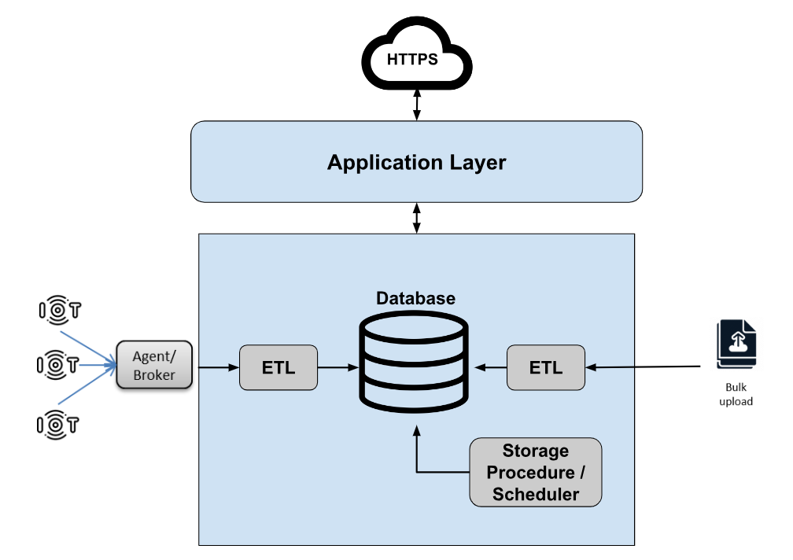
High Level Solution Architecture

Slide 6
Why GCP Platform ?
Strong Focus on Data Analytics and Machine Learning
Networking and Infrastructure
Innovative Technologies and Open Source Embrace
Cost and Pricing Models
Specialized Services
Environmental Sustainability

Slide 7
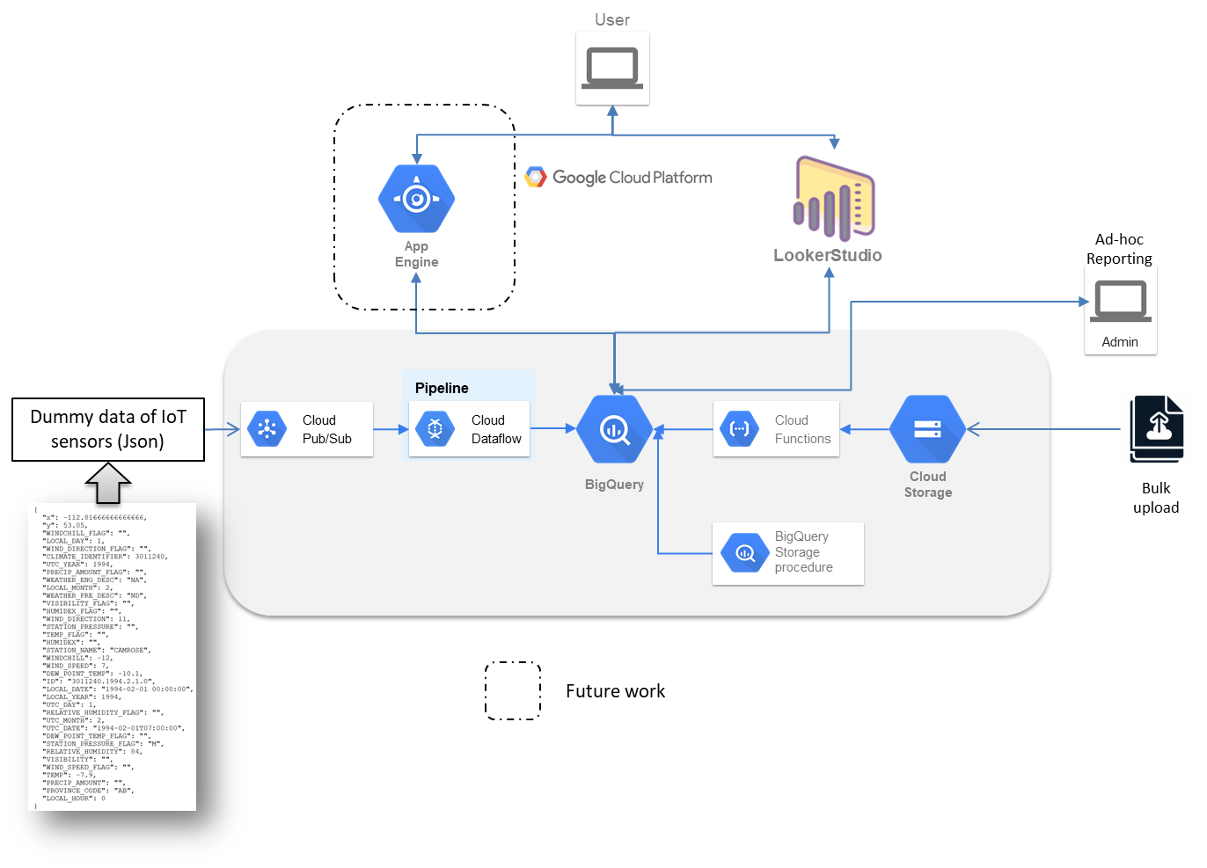
CAT Platform Process Flow in GCP

Slide 8
Functional Module of CAT Platform
Dashboard
Data Collection & Processing
Bulk Upload
Real-time data collection
Scheduler/Storage Procedure
Ad-hoc Reporting and Analysis

Slide 9
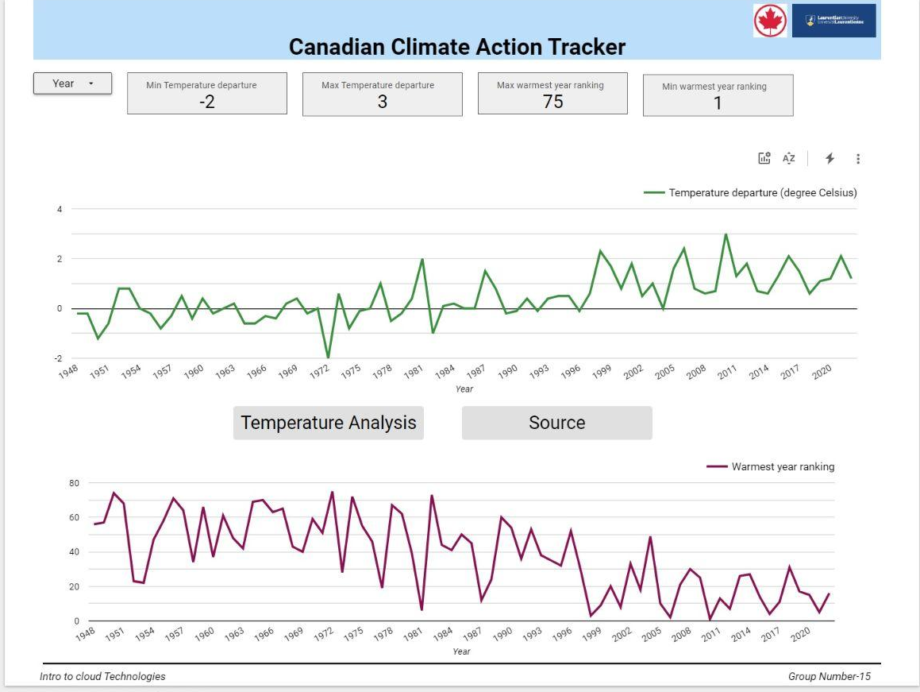
Dashboard of CAT
Demo

Slide 10
Data Collection and Process

Slide 11
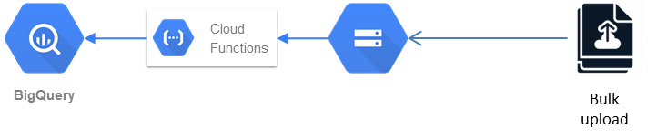
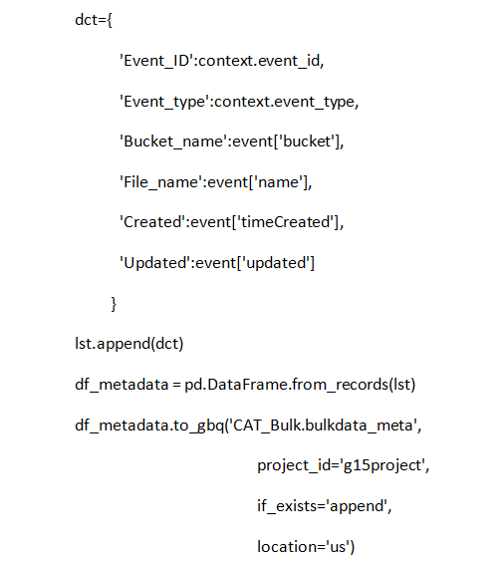
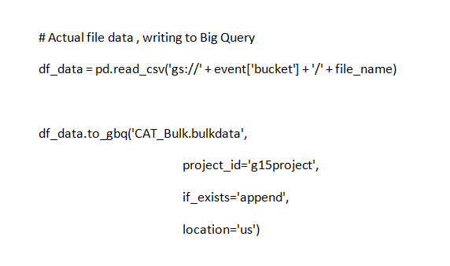
Bulk Upload
Demo
Python 3.9

Slide 12
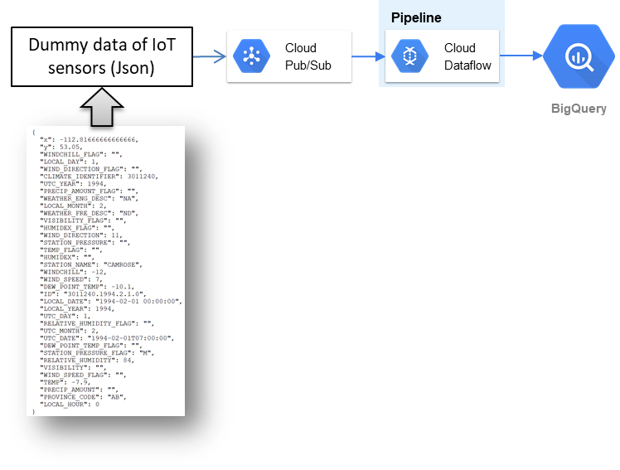
Real-Time Data Collection
Demo

Slide 13
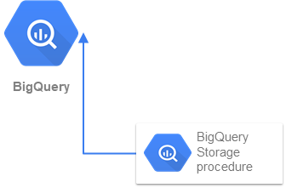
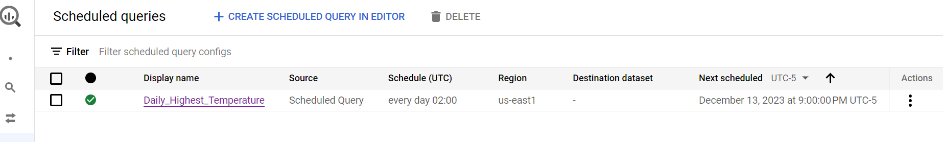
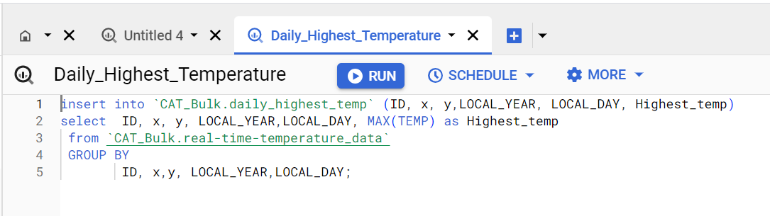
Scheduler / Storage Procedure
Demo

Slide 14
Ad-Hoc Reporting
Integration with Data Visualization Tools
BigQuery ML for Predictive Modeling (Future Plan)
SQL for Trend Analysis
Advanced Analytics Extensions (Standard SQL)
Real-time Data Analysis for Trend Monitoring
Geospatial Visualization (Future Plan)

Slide 15
Future Work
Implement App-Engine
Integration with IoT sensor devices
BigQuery ML for Predictive Modeling
Geospatial Visualization

Slide 16
References
[1]. Climate Data Canada. (2023, January 26). Location — Climate Data Canada. https://climatedata.ca/explore/location/?loc=JBVRD&location-select-temperature=tx_max&location-select-precipitation=r1mm&location-select-other=frost_days
[2]. Canada, E. a. C. C. (n.d.). Climate data extraction tool. https://climate-change.canada.ca/climate-data/#/downscaled-data
[3]. Index of climate. (n.d.). https://dd.weather.gc.ca/climate/
[4]. Canada, E. a. C. C. (n.d.-b). Climate data extraction tool. https://climate-change.canada.ca/climate-data/#/hourly-climate-data
[5]. The Climate Action Tracker. (n.d.). https://climateactiontracker.org/about/
[6]. Gil, L. (2023, October 27). Cloud Pricing Comparison: AWS vs. Azure vs. Google Cloud Platform in 2023. CAST AI – Kubernetes Automation Platform. https://cast.ai/blog/cloud-pricing-comparison-aws-vs-azure-vs-google-cloud-platform/
[7]. Wickramasinghe, S. (n.d.). AWS vs Azure vs GCP: Comparing The Big 3 Cloud Platforms. BMC Blogs. https://www.bmc.com/blogs/aws-vs-azure-vs-google-cloud-platforms/

Slide 17
Question ?

Slide 18
Thank You

